Slide 1

CMU Portugal
Advanced Training Program
Multimodal Conversational AI and Generative AI
JOÃO MAGALHÃES
NOVA SCHOOL OF SCIENCE AND TECHNOLOGY
VASCO RAMOS
NOVA SCHOOL OF SCIENCE AND TECHNOLOGY
BRUNO MARTINS
INSTITUTO SUPERIOR TÉCNICO

Slide 2

Accurate, Reliable, Trustworthy AI
Why does this matter?
Although we only tend to speak about its powerful performance, AI systems possess limitations!
Struggles with outdated knowledge
User: "What is the latest price of Bitcoin?"
AI Response: "I don’t have real-time access to financial markets, but as of my last training data (2023), Bitcoin was around $30,000.
Knowledge is frozen at the time of training!

Slide 3
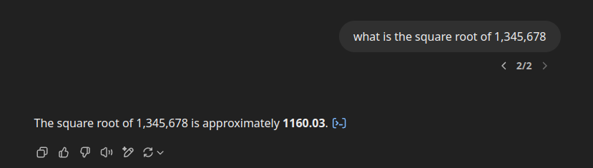
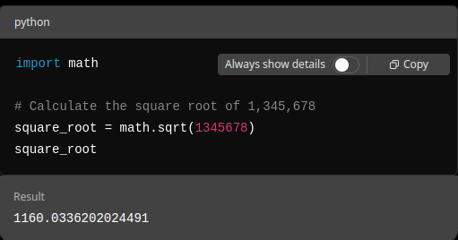
Accurate, Reliable, Trustworthy AI
Why does this matter?
Although we only tend to speak about its powerful performance, AI systems possess limitations!
Lacks direct tool interaction
Knowledge is frozen at the time of training
User: "Can you calculate the square root of 1,345,678?
AI Response: "I think it’s around 1158, but I can't verify that."

Slide 4
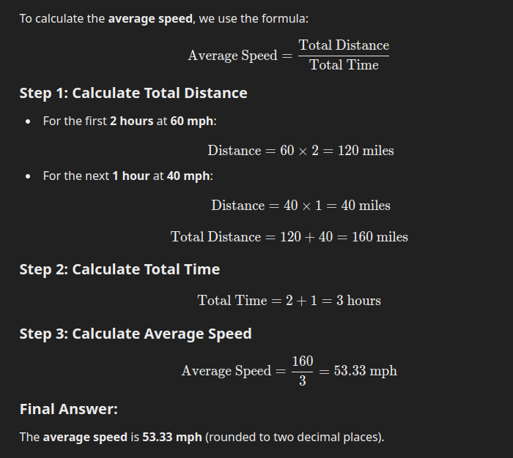
Accurate, Reliable, Trustworthy AI
Why does this matter?
Although we only tend to speak about its powerful performance, AI systems possess limitations!
Incorrect decisions
User: "If a train travels 60 mph for 2 hours and then 40 mph for 1 hour, what is the average speed?"
AI Response: "The average speed is (60 + 40) / 2 = 50 mph."
Jumps to the most statistically likely answer

Slide 5



Accurate, Reliable, Trustworthy AI
Retrieval Augmented Generation
Tool Composition
Chain-of-Thought
Grounds responses in external data
Define how different tools interact
Makes reasoning explicit/traceable
Knowledge cut-off
Hallucination issues
Complex tasks
Tool calling
Identify where it “all went wrong”

Slide 6
Accurate, Reliable, Trustworthy AI
What do these systems have in common?
Improve model performance without the need for retraining
“Mix and match” add-ons to existing systems
Model agnostic: they can work with different underlying architectures

Slide 7

Retrieval Augmented Generation

Slide 8
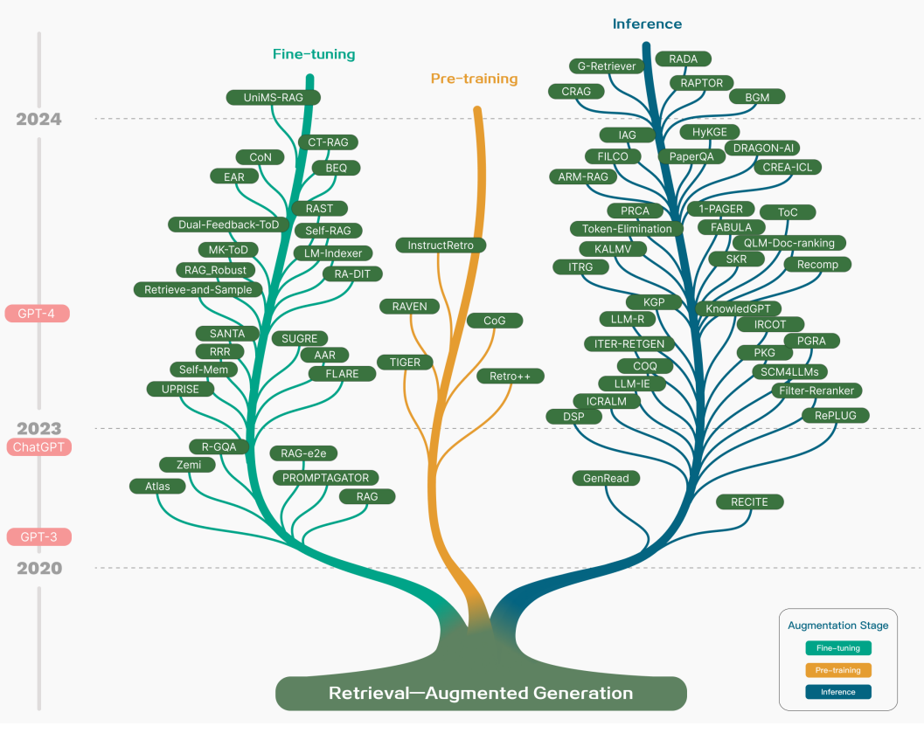
Retrieval Augmented Generation
Definition: Framework that retrieves relevant document segments from an external knowledge base
It can be incorporated during pre-training, fine-tuning, and inference
User
Generation
User
Retrieval
Generation
GAO, Yunfan, et al. Retrieval-augmented generation for large language models: A survey. arXiv preprint arXiv:2312.10997, 2023.

Slide 9
Retrieval Augmented Generation
Pre-training: Used to enhance the training dataset by incorporating external documents during training
Fine-tuning: Used to incorporate domain-specific information during task specialization
Inference: Used to fetch the latest information instead of relying on static knowledge
GAO, Yunfan, et al. Retrieval-augmented generation for large language models: A survey. arXiv preprint arXiv:2312.10997, 2023.

Slide 10
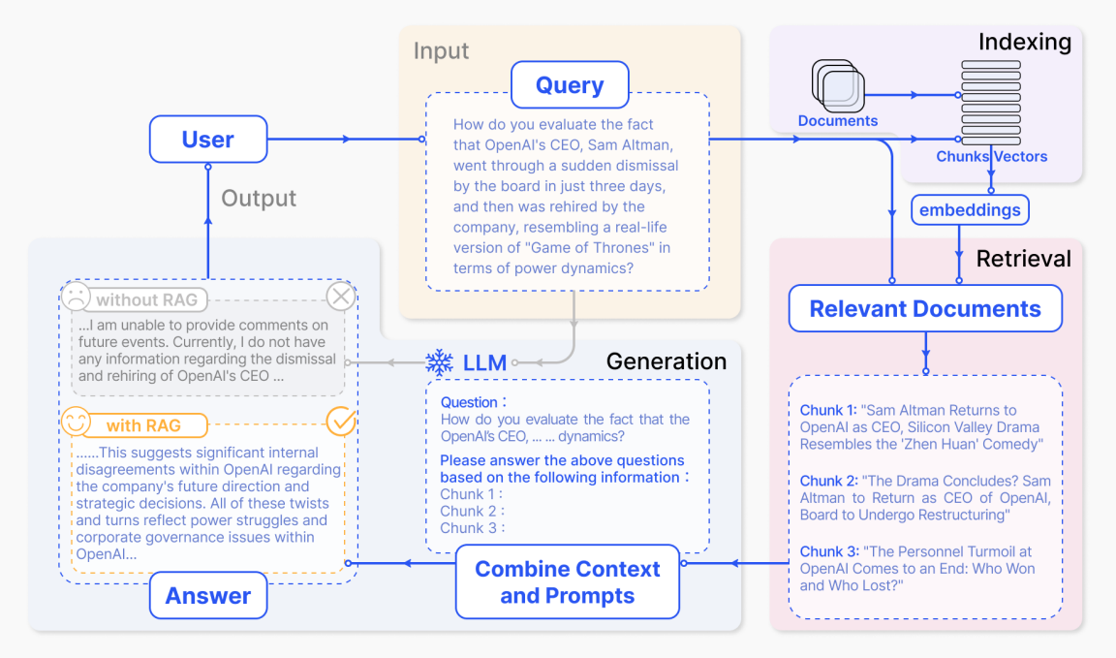
RAG: An Overview
1
Indexing: Documents split into chunks are embedded and stored in a database
Retrieval: Retrieve the top k most relevant segments to the question
Generation: The input becomes the original user question and the retrieved information
3
2
GAO, Yunfan, et al. Retrieval-augmented generation for large language models: A survey. arXiv preprint arXiv:2312.10997, 2023.

Slide 11
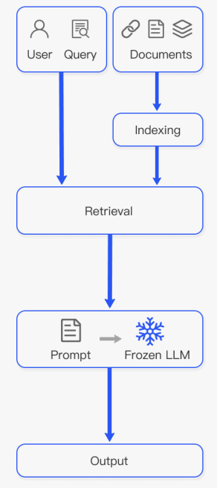
“Naive” RAG
Follows the traditional process of “Retrieve-Read”
Indexing
Retrieval
Generation
Data extraction/cleaning
Text segmentation
Embedding generation
Database
Query + Top-k = prompt
Output
Same embedding model
Similarity-based search
Top-k chunks
GAO, Yunfan, et al. Retrieval-augmented generation for large language models: A survey. arXiv preprint arXiv:2312.10997, 2023.

Slide 12
“Naive” RAG: Limitations
Challenges associated with retrieval
Precision; recall
Inexistence of relevant information
2. Disjointed/incoherent outputs
Redundancy
Stylistic/Tonal inconsistency
3. Hallucinations, bias, toxicity…
GAO, Yunfan, et al. Retrieval-augmented generation for large language models: A survey. arXiv preprint arXiv:2312.10997, 2023.

Slide 13
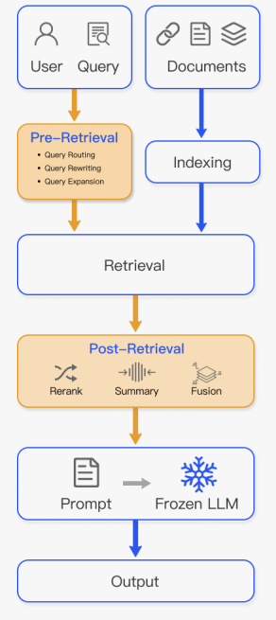
Advanced RAG
Focuses on enhancing retrieval quality!
1
1
2
Pre-Retrieval
Post-Retrieval
2
Optimizing the index structure and original query
Effectively integrating the relevant content into the query
Quality of the content being indexed
User request more suitable for the retrieval task
Relocating the relevant content to the edges of the prompt: avoids information overload
GAO, Yunfan, et al. Retrieval-augmented generation for large language models: A survey. arXiv preprint arXiv:2312.10997, 2023.

Slide 14
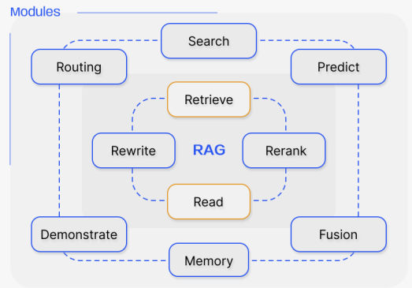
Modular RAG
Builds upon the two former RAG paradigms, enhancing adaptability and versatility
Adds new specialized modules to improve retrieval and processing capabilities
1
1
Search Module
Adapts to specific scenarios by directly searching multiple data sources: databases, web sources
GAO, Yunfan, et al. Retrieval-augmented generation for large language models: A survey. arXiv preprint arXiv:2312.10997, 2023.

Slide 15
Modular RAG
Builds upon the two former RAG paradigms, enhancing adaptability and versatility
Adds new specialized modules to improve retrieval and processing capabilities
2
Fusion Module
Uses a multi-query strategy
Parallel vector searches
2
GAO, Yunfan, et al. Retrieval-augmented generation for large language models: A survey. arXiv preprint arXiv:2312.10997, 2023.

Slide 16
Modular RAG
Builds upon the two former RAG paradigms, enhancing adaptability and versatility
Adds new specialized modules to improve retrieval and processing capabilities
3
Memory Module
Guided retrieval: allows to uncover “deeper” information than only surface-level matchings
Reduces repetitive queries
3
GAO, Yunfan, et al. Retrieval-augmented generation for large language models: A survey. arXiv preprint arXiv:2312.10997, 2023.

Slide 17
Modular RAG
Builds upon the two former RAG paradigms, enhancing adaptability and versatility
Adds new specialized modules to improve retrieval and processing capabilities
4
4
Routing Module
Navigates through multiple data sources selecting the optimal pathway for a query
Summarization, specific database searches, or merging different information sources.
GAO, Yunfan, et al. Retrieval-augmented generation for large language models: A survey. arXiv preprint arXiv:2312.10997, 2023.

Slide 18
Modular RAG
Builds upon the two former RAG paradigms, enhancing adaptability and versatility
Adds new specialized modules to improve retrieval and processing capabilities
5
5
Predict Module
Ensures retrieved information is accurate and relevant
Uses LLM context generation
GAO, Yunfan, et al. Retrieval-augmented generation for large language models: A survey. arXiv preprint arXiv:2312.10997, 2023.

Slide 19
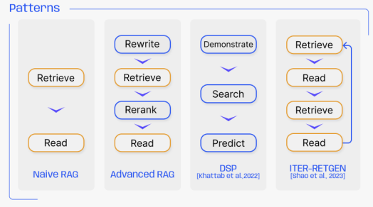
Modular RAG
It allows module substitution/reconfiguration to address a specific challenge. Modular RAG gos beyond a fixed “Retrieve-Read” structure
Demonstrate-Search-Predict
5
The system learns from examples
Retrieves the data
Predicts better outcomes
GAO, Yunfan, et al. Retrieval-augmented generation for large language models: A survey. arXiv preprint arXiv:2312.10997, 2023.

Slide 20
Modular RAG: DSP
User query: What is the best treatment for a 55-year-old patient with Stage 2 Hypertension, a BMI of 28, and a history of Type 2 Diabetes?
Extracts key patient details: Age, condition (Stage 2 Hypertension), BMI, comorbidities (Diabetes).
Prepares a search query for finding relevant past cases.
Demonstrate
Predict
The model retrieves past cases from a medical database:
Patients with similar age, BMI…
Successful treatment plans
Cases verified by medical professionals
Output:
"Based on similar patient cases and the latest medical guidelines, the optimal treatment for your patient is:
ACE inhibitors;
Metformin…"
Search
The system queries trusted medical sources
GAO, Yunfan, et al. Retrieval-augmented generation for large language models: A survey. arXiv preprint arXiv:2312.10997, 2023.

Slide 21
Modular RAG
It allows module substitution/reconfiguration to address a specific challenge. Modular RAG gos beyond a fixed “Retrieve-Read” structure
Retrieve-Read-Retrieve-Read
5
An initial retrieval step
The retrieved data is processed
The retrieval process is refined
Outputs the answer
GAO, Yunfan, et al. Retrieval-augmented generation for large language models: A survey. arXiv preprint arXiv:2312.10997, 2023.

Slide 22
Modular RAG: ITER-RETGEN
User query: What were the main causes of the Great Depression, and how did government policies influence the economic recovery?
Extracts key topics from the query: Causes of the Great Depression, Government policies, Economic recovery.
Breaks the query into subtopics:
What were the primary economic factors?
What major policies were introduced?
How did they impact recovery?
What specific government policies influenced recovery?
Were some policies more effective than others?
What do historical economic reports say about the recovery timeline?
Retrieval
Read
The system retrieves broad, high-level historical sources
Lacks specific data and expert perspectives
The system analyzes the retrieved sources and determines what’s missing:
Query refinement!
GAO, Yunfan, et al. Retrieval-augmented generation for large language models: A survey. arXiv preprint arXiv:2312.10997, 2023.

Slide 23
Modular RAG: ITER-RETGEN
User query: What were the main causes of the Great Depression, and how did government policies influence the economic recovery?
Extracts key topics from the query: Causes of the Great Depression, Government policies, Economic recovery.
Breaks the query into subtopics:
What were the primary economic factors?
What major policies were introduced?
How did they impact recovery?
Retrieval
Read
More targeted retrieval, with more relevant documents:
Federal Reserve Report (1934): “The introduction of the Glass-Steagall Act stabilized banking confidence.”
Historical News Articles: Public reactions to government stimulus programs were divided between support and criticism.
The system combines insights from both retrieval rounds and outputs a response
“The Great Depression was caused by a combination of financial collapse and weak early policy responses. Recovery efforts, such as the New Deal, improved economic stability, but long-term recovery required large-scale government intervention and war-related production."
GAO, Yunfan, et al. Retrieval-augmented generation for large language models: A survey. arXiv preprint arXiv:2312.10997, 2023.

Slide 24
RAG vs Fine-tuning
LLM augmentation is continuously compared to fine-tuning but both techniques effectively serve different purposes.
RAG
Fine-tuning
External knowledge at runtime
Dynamic: Retrieves the latest information
No need for frequent retraining
Best for fast-changing information (e.g., news, finance, law, healthcare)
Higher Hallucination risk
Learns from a fixed dataset
Static: Once trained, knowledge is frozen
Requires retraining
Best for domain-specific expertise (e.g., medical AI, legal models, customer support)
Lower Hallucination risk
GAO, Yunfan, et al. Retrieval-augmented generation for large language models: A survey. arXiv preprint arXiv:2312.10997, 2023.

Slide 25



RAG in the wild: Silicium Sailor
A system designed to facilitate access to navy operational manuals and protocols, particularly during navigation and rescue scenarios.
LLM that reads and processes official Navy and NATO manuals
The system provides highly reliable and trustworthy answers by consistently grounding responses in official publications.
Official Document Grounding
Auditable decisions
LLM Guardrails

Slide 26

Exercise Time
26

Slide 27
Tool Composition

Slide 28





Tool Composition
Allows models to use external tools — search engines, APIs, databases, — to perform specialized tasks beyond their native capabilities
Calculator
Search Engine
Database queries
Translation
Code Interpreter
Wang, Zhiruo, et al. "What are tools anyway? a survey from the language model perspective." arXiv preprint arXiv:2403.15452 (2024).

Slide 29
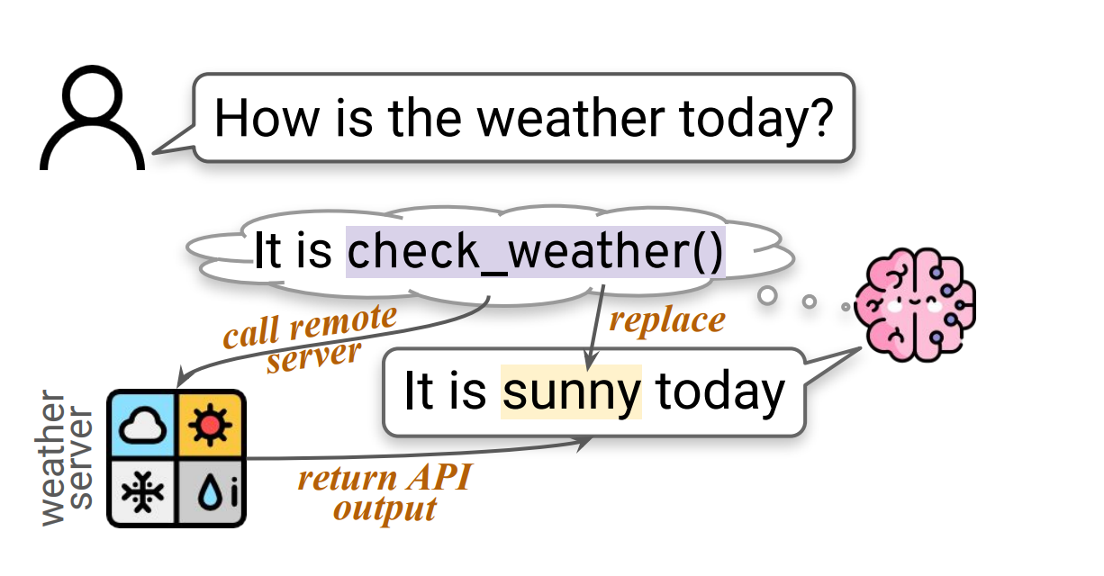
Tool Composition: An Overview
Step-by-Step Process:
The system identifies when a task requires external tools
Selecting the most appropriate tool
The model sends the query to the tool and retrieves an answer
The answer is integrated into a coherent, “natural” output
Wang, Zhiruo, et al. "What are tools anyway? a survey from the language model perspective." arXiv preprint arXiv:2403.15452 (2024).

Slide 30



Tool Composition: Different Approaches
Human-Annotated
Task-Specific
Self-Learning
Researchers annotate when and how the model should call a tool
Models trained to use tools for a specific task
The model is capable of deciding when and how to use tools
Wang, Zhiruo, et al. "What are tools anyway? a survey from the language model perspective." arXiv preprint arXiv:2403.15452 (2024).

Slide 31


Tool Composition: Human-Annotated
The models learn to use tools by training on datasets manually labelled by humans
The model learns patterns of tool usage!
LaMDA
Trained using high-quality conversations, where human annotators guided AI responses, including when to use search engines or calculators
Calculator
Translator
Information Retrieval System
Wang, Zhiruo, et al. "What are tools anyway? a survey from the language model perspective." arXiv preprint arXiv:2403.15452 (2024). Thoppilan, R., De Freitas, D., Hall, J., Shazeer, N., Kulshreshtha, A., Cheng, H. T., ... & Le, Q. (2022). Lamda: Language models for dialog applications. arXiv preprint arXiv:2201.08239.

Slide 32
Tool Composition: Human-Annotated
To collect training data for the fine-tuning used in the algorithm, we use both static and interactive methods again. The key difference from the other sub-tasks is that the crowdworkers are not reacting to the model’s output, but rather intervening to correct it in a way that LaMDA can learn to imitate. In the interactive case, a crowdworker carries out a dialog with LaMDA, whereas in the static case, they read over records of earlier dialogs, turn by turn. The crowdworker decides whether each statement contains any claims that might require reference to an external knowledge source. If so, they are asked whether the claims are about anything other than the persona improvised by LaMDA, and then whether they go beyond simple matters of common sense. If the answer to any of these questions is ’no’, the model’s output is marked ‘good’, and the dialog moves on. Otherwise, the crowdworker is asked to research the claims using the toolset, via a text-in and text-out interface. The interface to the set of tools used here is identical to the service used by the algorithm at inference time. Given a general text query, the information retrieval system returns a set of brief, text-only snippets in rank order. Snippets of open-web content include URLs for their source, answers provided directly by the information retrieval system, (e.g., the current time) or by the calculator tool do not. When the user has finished running queries, they have the opportunity to rewrite the model’s statement to include well-sourced claims. If they used open-web content, we ask them to cite the URLs needed to support any responses which contain information pertaining to the external world. URLs can be appended to the end of the message, or if the context warrants it, they can be attached inline to particular words in the response using Markdown format.
Wang, Zhiruo, et al. "What are tools anyway? a survey from the language model perspective." arXiv preprint arXiv:2403.15452 (2024). Thoppilan, R., De Freitas, D., Hall, J., Shazeer, N., Kulshreshtha, A., Cheng, H. T., ... & Le, Q. (2022). Lamda: Language models for dialog applications. arXiv preprint arXiv:2201.08239.

Slide 33



Tool Composition: Human-Annotated
Limitations:
Expensive and time-consuming
Lots of human annotated data
Hard to Scale
Needs continuous updates
Limited Generalization
Only predefined tool use cases
Wang, Zhiruo, et al. "What are tools anyway? a survey from the language model perspective." arXiv preprint arXiv:2403.15452 (2024). Thoppilan, R., De Freitas, D., Hall, J., Shazeer, N., Kulshreshtha, A., Cheng, H. T., ... & Le, Q. (2022). Lamda: Language models for dialog applications. arXiv preprint arXiv:2201.08239.

Slide 34
Tool Composition: Task-Specific
The models are trained to use tools only for very specific tasks.
Calculators
Math
Predefined toolset:
Fixed set of tools for specific queries
Task assignments are explicit
Trained separately for each tool
Hard Coded logic
The model does not autonomously select which tool to use
Databases
Finance
Wang, Zhiruo, et al. "What are tools anyway? a survey from the language model perspective." arXiv preprint arXiv:2403.15452 (2024).

Slide 35
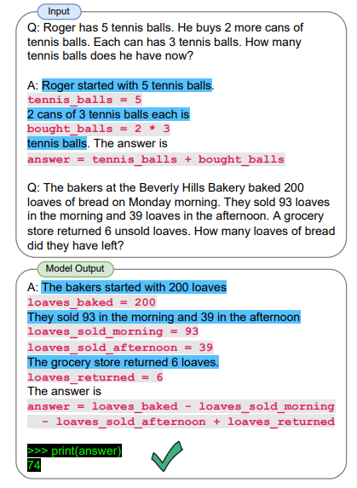
Tool Composition: Task-Specific
Program-aided Language Models: PaL
Reads natural language problems and generates programs, offloading the solution step to a Python interpreter
Wang, Zhiruo, et al. "What are tools anyway? a survey from the language model perspective." arXiv preprint arXiv:2403.15452 (2024). Gao, L., Madaan, A., Zhou, S., Alon, U., Liu, P., Yang, Y., ... & Neubig, G. (2023, July). Pal: Program-aided language models. In International Conference on Machine Learning (pp. 10764-10799). PMLR.

Slide 36
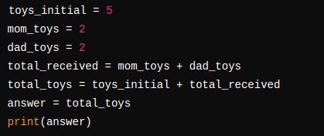
Tool Composition: Task-Specific
Program-aided Language Models: PaL
Two phases of training:
Pre-training: Model learns general reasoning and code generation
Few-shot Prompting: Model is provided examples of problems with step-by-step code solutions
Shawn has 5 toys. For Christmas, he got 2 toys each from his mom and dad. How many toys does he have now?
Wang, Zhiruo, et al. "What are tools anyway? a survey from the language model perspective." arXiv preprint arXiv:2403.15452 (2024). Gao, L., Madaan, A., Zhou, S., Alon, U., Liu, P., Yang, Y., ... & Neubig, G. (2023, July). Pal: Program-aided language models. In International Conference on Machine Learning (pp. 10764-10799). PMLR.

Slide 37
Tool Composition: Task-Specific
Limitations:
Limited flexibility
The model can only use the tools it was explicitly trained to use
Lack of generalization
It cannot handle a task outside its predefined function
Requires multiple models
Different models for different tools
Not adaptive
No autonomous decision
Wang, Zhiruo, et al. "What are tools anyway? a survey from the language model perspective." arXiv preprint arXiv:2403.15452 (2024). Gao, L., Madaan, A., Zhou, S., Alon, U., Liu, P., Yang, Y., ... & Neubig, G. (2023, July). Pal: Program-aided language models. In International Conference on Machine Learning (pp. 10764-10799). PMLR.

Slide 38

Tool Composition: Self-Learning
The model doesn’t just memorize fixed rules: it learns when and how to use a given tool!
Tool usage is learned in a self-supervised way
Comprehensive tool usage not tied to a specific task
Human-Annotated
Generalization
Human-Annotated | Pre-labeled training data on when to use tools
Task-Specific | Trained only for a single tool/domain
Self-Learning | The model autonomously decides when/how to use tools
Wang, Zhiruo, et al. "What are tools anyway? a survey from the language model perspective." arXiv preprint arXiv:2403.15452 (2024).

Slide 39
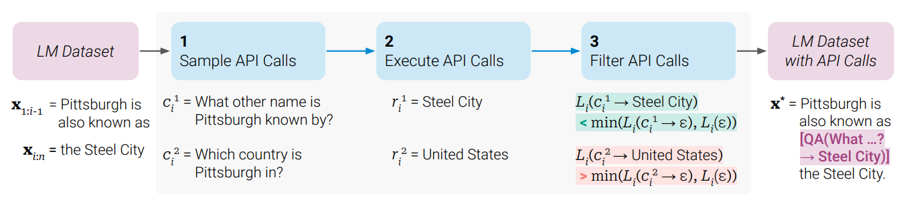
Tool Composition: ToolFormer
Objective: The LLM learns to use different tools through API calls
Step 1: Self-supervised Annotation
The model is given a couple of human-written examples of API calls
This is a pre-trained model: it already has seen code, API calls, and structured text!
The model starts generating its own API calls for different queries
Few-shot Prompting
Wang, Zhiruo, et al. "What are tools anyway? a survey from the language model perspective." arXiv preprint arXiv:2403.15452 (2024). Schick, T., Dwivedi-Yu, J., Dessì, R., Raileanu, R., Lomeli, M., Hambro, E., ... & Scialom, T. (2024). Toolformer: Language models can teach themselves to use tools. Advances in Neural Information Processing Systems, 36.
🔹 Step 1: Generating API Calls (Self-Supervised Annotation)
Toolformer is given a handful of human-written examples of API calls.
It autonomously generates potential API calls within a dataset based on these few-shot prompts.
Example: Before Training: “What’s the capital of France?” AI Guess: “Paris” (May be incorrect or outdated) After Self-Supervised Training: “What’s the capital of France?” → [WikiSearch(“Capital of France”)] → “Paris” ✅ AI calls the Wikipedia search tool instead of guessing!
🔹 Step 2: Executing API Calls
The AI sends generated API calls to external tools (e.g., search engines, calculators, translation APIs).
These tools return factual, real-time responses.
🔹 Step 3: Filtering Useful API Calls
Toolformer compares generated responses to its own predictions and asks: “Did this API call improve my answer?”
If yes, it keeps the API call; if no, it discards it.
This reinforces the best tool-use strategies while removing unnecessary calls.
🔹 Step 4: Fine-Tuning on the New Dataset
The AI is fine-tuned on its filtered dataset, allowing it to automatically integrate API calls into its responses when needed.
📌 Key Insight: Toolformer doesn’t need explicit human supervision—it refines its tool-use skills by evaluating its own performance!

Slide 40
Tool Composition: ToolFormer
Objective: The LLM learns to use different tools through API calls
Step 2: Executing API Calls
Toolformer test its own generated API calls by inserting them into queries
1
2
3
The model decides when a tool is needed and adds an API call
Execute the API call and retrieve the response
Compare API output vs. Model’s Own Predict
What is the exchange rate of USD to EUR today?
1 USD = 0.91 EUR
API result more reliable?
Keep the tool use!
exchange_rate(USD, EUR)
API didn’t add value?
Remove it!
Wang, Zhiruo, et al. "What are tools anyway? a survey from the language model perspective." arXiv preprint arXiv:2403.15452 (2024). Schick, T., Dwivedi-Yu, J., Dessì, R., Raileanu, R., Lomeli, M., Hambro, E., ... & Scialom, T. (2024). Toolformer: Language models can teach themselves to use tools. Advances in Neural Information Processing Systems, 36.
🔹 Step 2: Executing API Calls
The AI sends generated API calls to external tools (e.g., search engines, calculators, translation APIs).
These tools return factual, real-time responses.
🔹 Step 3: Filtering Useful API Calls
Toolformer compares generated responses to its own predictions and asks: “Did this API call improve my answer?”
If yes, it keeps the API call; if no, it discards it.
This reinforces the best tool-use strategies while removing unnecessary calls.
🔹 Step 4: Fine-Tuning on the New Dataset
The AI is fine-tuned on its filtered dataset, allowing it to automatically integrate API calls into its responses when needed.
📌 Key Insight: Toolformer doesn’t need explicit human supervision—it refines its tool-use skills by evaluating its own performance!

Slide 41
Tool Composition: ToolFormer
Objective: The LLM learns to use different tools through API calls
Step 3: Fine-Tuning on Filtered API Calls
By only keeping examples where API calls improved accuracy, it creates a dataset where tool usage is properly aligned with relevant queries
The model is fine-tuned on this optimized dataset
Toolformer can apply tool-use strategies to unseen problems!
The model decides dynamically whether a tool is needed!
Wang, Zhiruo, et al. "What are tools anyway? a survey from the language model perspective." arXiv preprint arXiv:2403.15452 (2024). Schick, T., Dwivedi-Yu, J., Dessì, R., Raileanu, R., Lomeli, M., Hambro, E., ... & Scialom, T. (2024). Toolformer: Language models can teach themselves to use tools. Advances in Neural Information Processing Systems, 36.
🔹 Step 4: Fine-Tuning on the New Dataset
The AI is fine-tuned on its filtered dataset, allowing it to automatically integrate API calls into its responses when needed.
📌 Key Insight: Toolformer doesn’t need explicit human supervision—it refines its tool-use skills by evaluating its own performance!

Slide 42
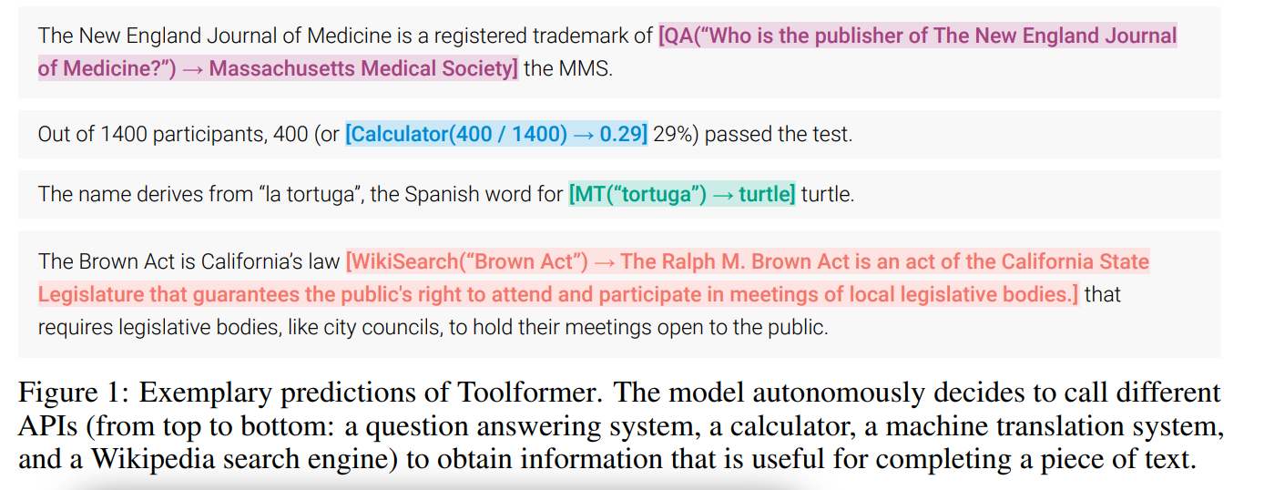
Tool Composition: ToolFormer
Wang, Zhiruo, et al. "What are tools anyway? a survey from the language model perspective." arXiv preprint arXiv:2403.15452 (2024).

Slide 43
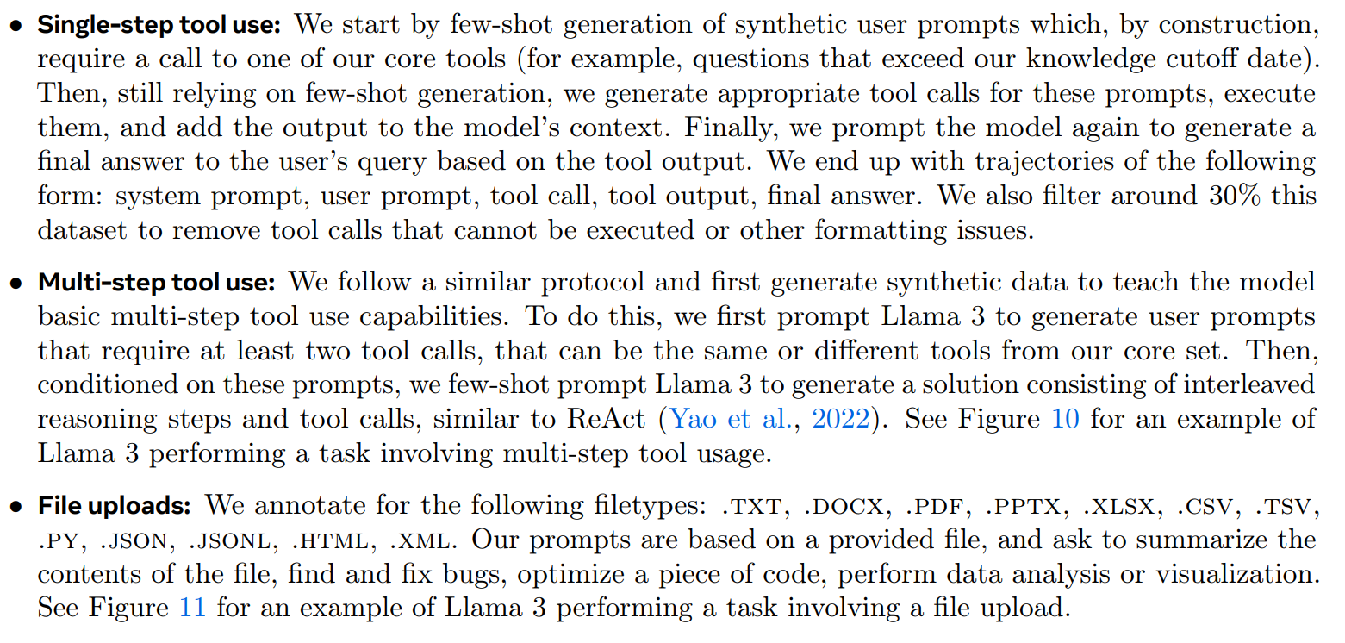
Tool Composition: Llama 3
Wang, Zhiruo, et al. "What are tools anyway? a survey from the language model perspective." arXiv preprint arXiv:2403.15452 (2024).

Slide 44
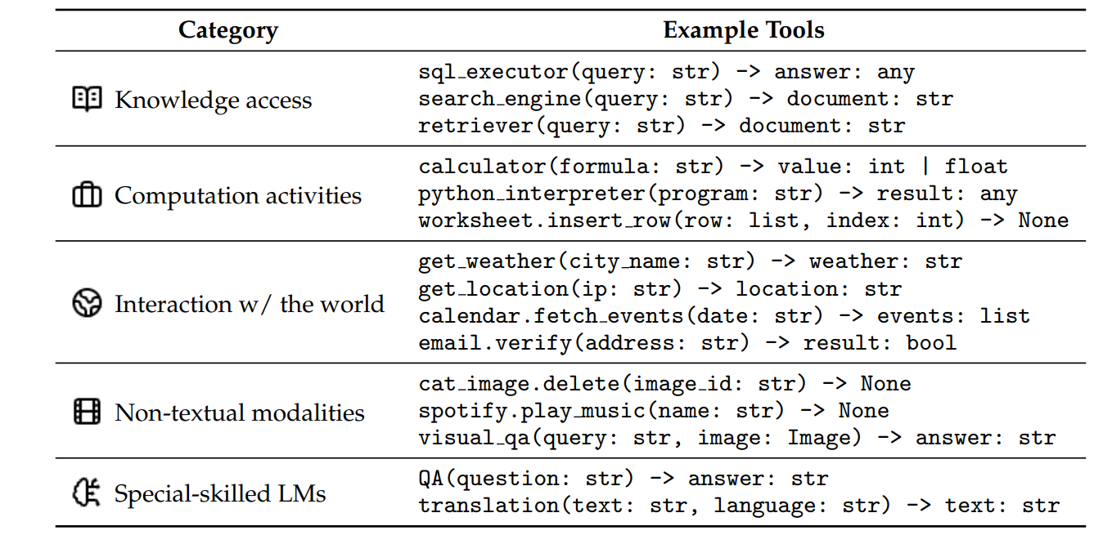
Tool Composition: Tools are useful!
Wang, Zhiruo, et al. "What are tools anyway? a survey from the language model perspective." arXiv preprint arXiv:2403.15452 (2024).

Slide 45
Chain-of-Thought

Slide 46
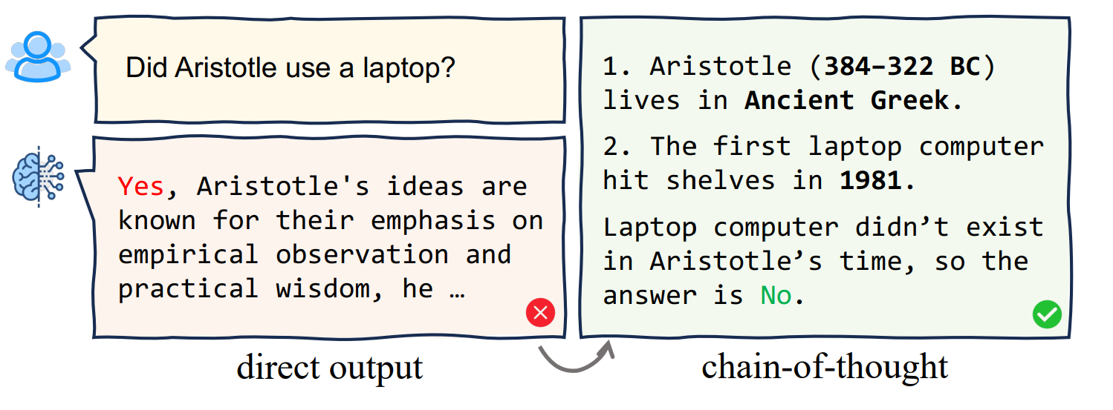
Chain-Of-Thought
Allows models to breakdown complex problems into multiple reasoning steps
Instead of directly providing the answer, CoT offers a step-by-step reasoning trajectory
Problem
Thoughts
Step
Step
Chain
Step
Step
Step
Step
Step
Step
Step
Step
Wei, J., Wang, X., Schuurmans, D., Bosma, M., Xia, F., Chi, E., ... & Zhou, D. (2022). Chain-of-thought prompting elicits reasoning in large language models. Advances in neural information processing systems, 35, 24824-24837. Chu, Z., Chen, J., Chen, Q., Yu, W., He, T., Wang, H., ... & Liu, T. (2024, August). Navigate through enigmatic labyrinth a survey of chain of thought reasoning: Advances, frontiers and future. In Proceedings of the 62nd Annual Meeting of the Association for Computational Linguistics (Volume 1: Long Papers) (pp. 1173-1203).

Slide 47



CoT: Why?
CoT offers several advantages:
Boosted Reasoning
Breaks down complex problems into manageable steps and establishes connections among these steps, thereby facilitating reasoning.
Interpretability
Reasoning is traceable! It leads to a more trustworthy system
Advanced Collaboration
Facilitates user-system interaction
Wei, J., Wang, X., Schuurmans, D., Bosma, M., Xia, F., Chi, E., ... & Zhou, D. (2022). Chain-of-thought prompting elicits reasoning in large language models. Advances in neural information processing systems, 35, 24824-24837. Chu, Z., Chen, J., Chen, Q., Yu, W., He, T., Wang, H., ... & Liu, T. (2024, August). Navigate through enigmatic labyrinth a survey of chain of thought reasoning: Advances, frontiers and future. In Proceedings of the 62nd Annual Meeting of the Association for Computational Linguistics (Volume 1: Long Papers) (pp. 1173-1203).

Slide 48



CoT: How?
Few-Shot CoT
Zero-Shot CoT
CoT Fine-Tuning
Reinforcement Learning
The model follows the pattern given in the examples
Instead of examples, the model is prompted tiwh “Let’s think step by step”
The model is trained on datasets with reasoning steps
The model learns to generate step-by-step reasoning over RL training iterations
Wei, J., Wang, X., Schuurmans, D., Bosma, M., Xia, F., Chi, E., ... & Zhou, D. (2022). Chain-of-thought prompting elicits reasoning in large language models. Advances in neural information processing systems, 35, 24824-24837. Chu, Z., Chen, J., Chen, Q., Yu, W., He, T., Wang, H., ... & Liu, T. (2024, August). Navigate through enigmatic labyrinth a survey of chain of thought reasoning: Advances, frontiers and future. In Proceedings of the 62nd Annual Meeting of the Association for Computational Linguistics (Volume 1: Long Papers) (pp. 1173-1203).

Slide 49
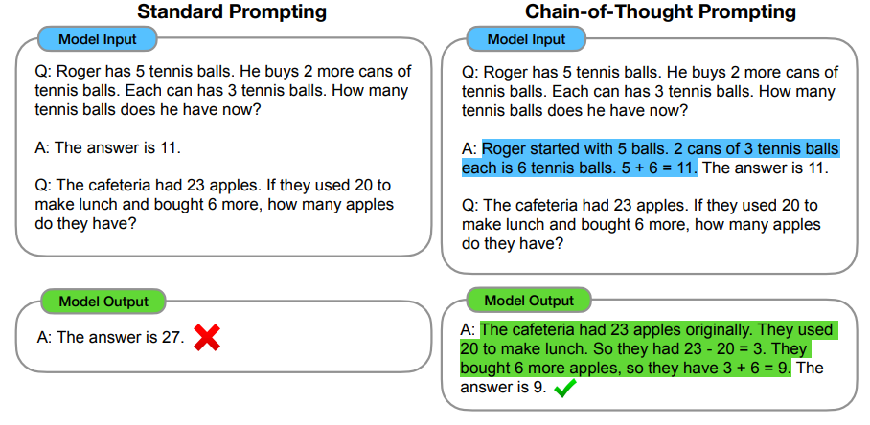
CoT: Few-Shot
The LLM is given a few examples of step-by-step reasoning to guide problem-solving
No fine-tuning
Well-crafted prompts
Mathematical
Scaling
Logic
(Too) Complex tasks
Wei, J., Wang, X., Schuurmans, D., Bosma, M., Xia, F., Chi, E., ... & Zhou, D. (2022). Chain-of-thought prompting elicits reasoning in large language models. Advances in neural information processing systems, 35, 24824-24837. Chu, Z., Chen, J., Chen, Q., Yu, W., He, T., Wang, H., ... & Liu, T. (2024, August). Navigate through enigmatic labyrinth a survey of chain of thought reasoning: Advances, frontiers and future. In Proceedings of the 62nd Annual Meeting of the Association for Computational Linguistics (Volume 1: Long Papers) (pp. 1173-1203).

Slide 50
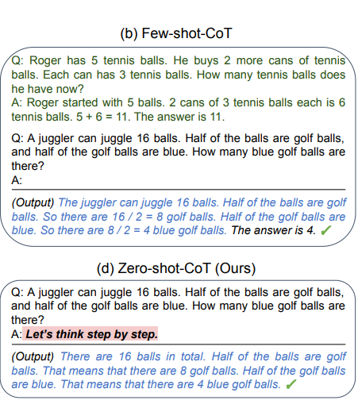
CoT: Zero-Shot
Another prompting technique where the prompt includes a phrase like “Let’s think step by step”
No fine-tuning
More error prone
No need for curated examples
Scaling
Maths, Logic, Commonsense
Base Model
Kojima, T., Gu, S. S., Reid, M., Matsuo, Y., & Iwasawa, Y. (2022). Large language models are zero-shot reasoners. Advances in neural information processing systems, 35, 22199-22213. Navigate through enigmatic labyrinth a survey of chain of thought reasoning: Advances, frontiers and future. In Proceedings of the 62nd Annual Meeting of the Association for Computational Linguistics (Volume 1: Long Papers) (pp. 1173-1203).

Slide 51
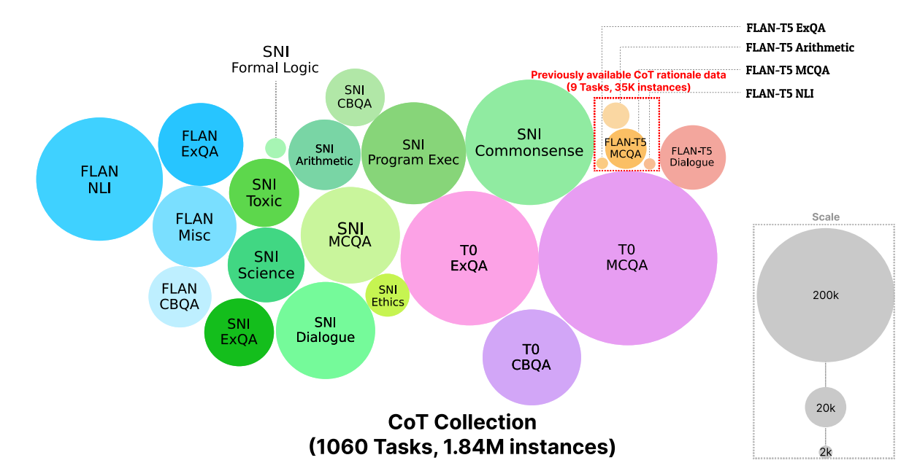
CoT: Fine-tuning
Fine-tuning will lead the model’s parameters to internalize step-by-step reasoning. At the end, the models will be able to generate structured CoT reasoning without requiring explicit prompts
Consistent reasoning
Large scale datasets
Multi-Step Reasoning
Computationally expensive
Generalization
Less flexible
Kim, S., Joo, S. J., Kim, D., Jang, J., Ye, S., Shin, J., & Seo, M. (2023). The cot collection: Improving zero-shot and few-shot learning of language models via chain-of-thought fine-tuning. arXiv preprint arXiv:2305.14045. Navigate through enigmatic labyrinth a survey of chain of thought reasoning: Advances, frontiers and future. In Proceedings of the 62nd Annual Meeting of the Association for Computational Linguistics (Volume 1: Long Papers) (pp. 1173-1203).

Slide 52
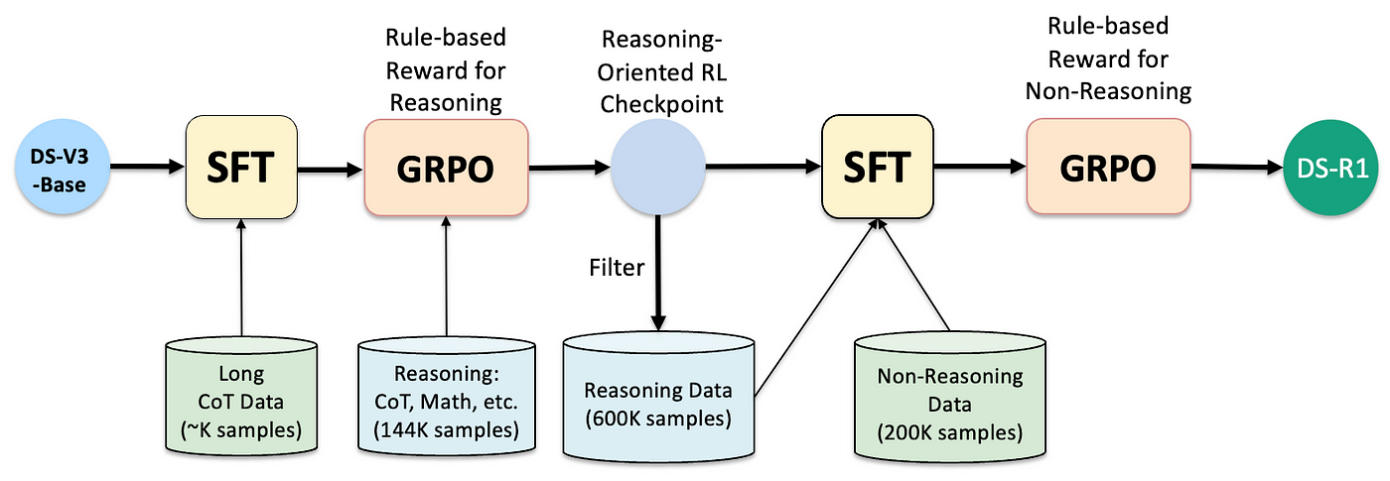
CoT: Reinforcement Learning
Fine-tuning will lead the model’s parameters to internalize step-by-step reasoning. At the end, the models will be able to generate structured CoT reasoning without requiring explicit prompts
Math
Code
DeepSeek-AI, Guo, D., Yang, D., Zhang, H., Song, J., Zhang, R., Xu, R., Zhu, Q., Ma, S., Wang, P., Bi, X., Zhang, X., Yu, X., Wu, Y., Wu, Z. F., Gou, Z., Shao, Z., Li, Z., Gao, Z., ... Zhang, Z. (2025). DeepSeek-R1: Incentivizing reasoning capability in LLMs via reinforcement learning. arXiv. https://arxiv.org/abs/2501.12948 Navigate through enigmatic labyrinth a survey of chain of thought reasoning: Advances, frontiers and future. In Proceedings of the 62nd Annual Meeting of the Association for Computational Linguistics (Volume 1: Long Papers) (pp. 1173-1203).

Slide 53
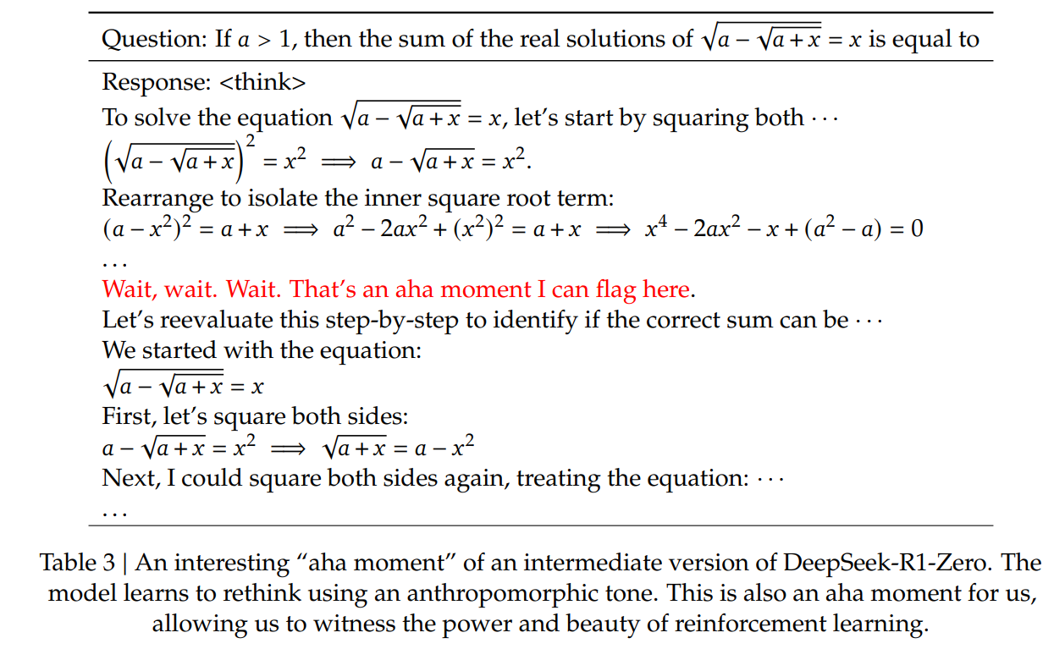
CoT: Reinforcement Learning
During this phase, DeepSeek-R1-Zero learns to allocate more thinking time to a problem by reevaluating its initial approach. This behavior is not only a testament to the model’s growing reasoning abilities but also a captivating example of how reinforcement learning can lead to unexpected and sophisticated outcomes.
Kim, S., Joo, S. J., Kim, D., Jang, J., Ye, S., Shin, J., & Seo, M. (2023). The cot collection: Improving zero-shot and few-shot learning of language models via chain-of-thought fine-tuning. arXiv preprint arXiv:2305.14045. Navigate through enigmatic labyrinth a survey of chain of thought reasoning: Advances, frontiers and future. In Proceedings of the 62nd Annual Meeting of the Association for Computational Linguistics (Volume 1: Long Papers) (pp. 1173-1203).

Slide 54
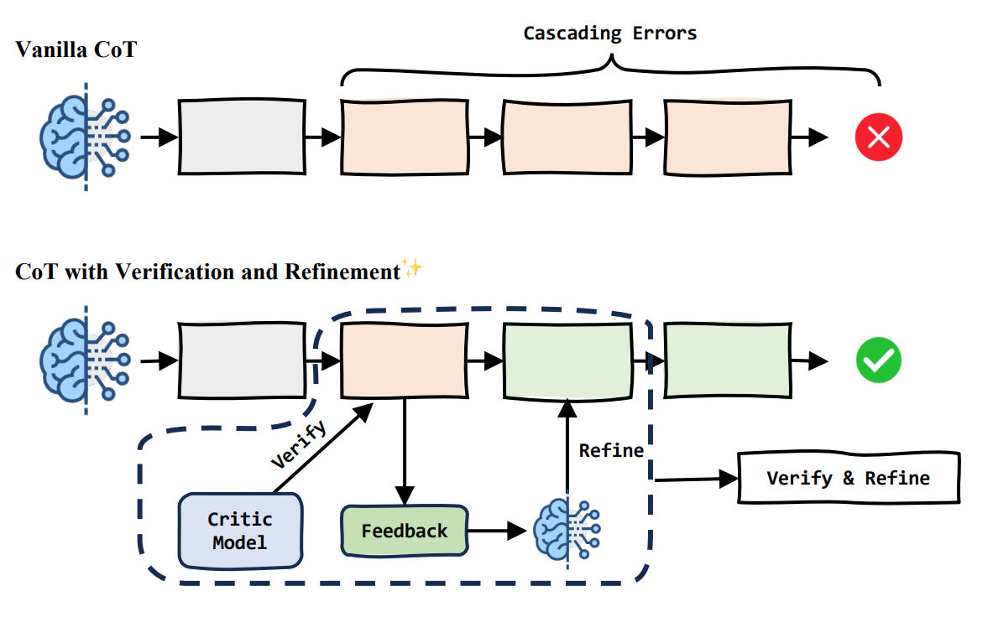
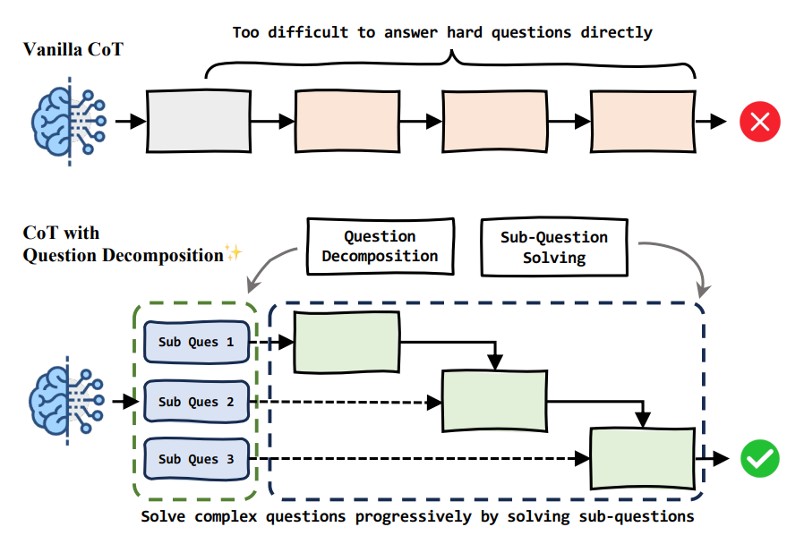
CoT: Challenges
Navigate through enigmatic labyrinth a survey of chain of thought reasoning: Advances, frontiers and future. In Proceedings of the 62nd Annual Meeting of the Association for Computational Linguistics (Volume 1: Long Papers) (pp. 1173-1203)

Slide 55
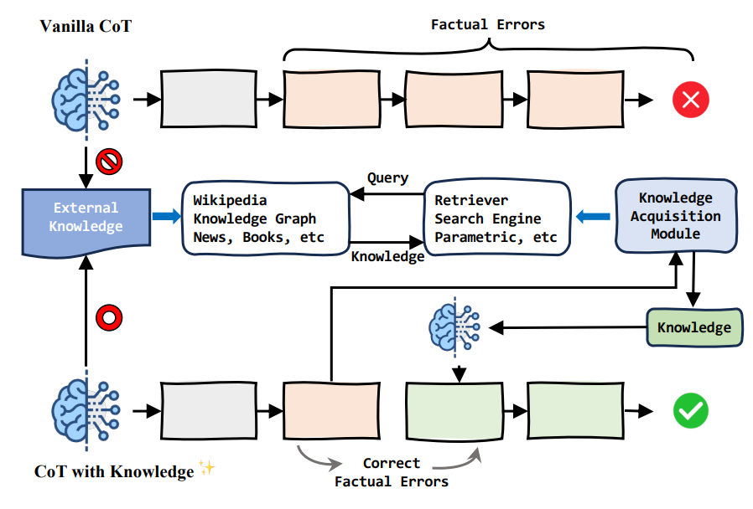
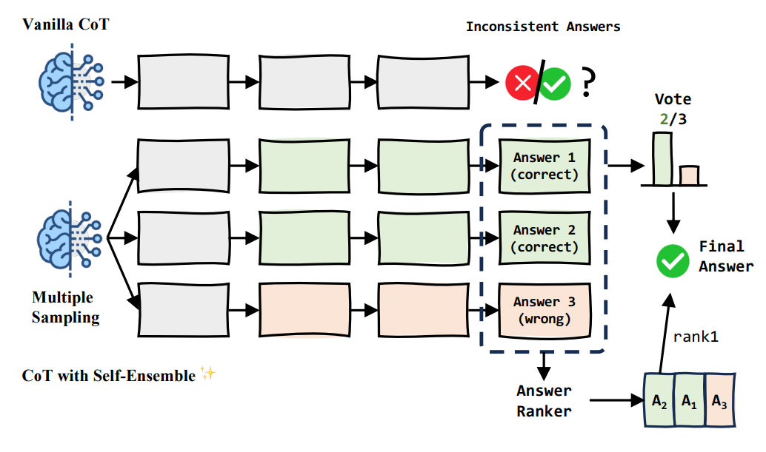
CoT: Challenges
Navigate through enigmatic labyrinth a survey of chain of thought reasoning: Advances, frontiers and future. In Proceedings of the 62nd Annual Meeting of the Association for Computational Linguistics (Volume 1: Long Papers) (pp. 1173-1203)

Slide 56
Key Takeaways
These LLM augmentation techniques enhance model capabilities!
Better Accuracy
The model can verify facts and reason logically.
Improved Decision-Making
CoT enables structured, interpretable responses
More Interactive AI
Tool composition allows models to execute tasks beyond text generation (e.g., running code, retrieving data)
More Scalable & Adaptive
RAG ensures up-to-date responses without retraining the entire model.

Slide 57
Exercise Time
57

Slide 58

Thank you!

